Slide 1
knit
pandoc
.lyx
.Rnw
.tex
.pdf
.pdf
.html
.doc
knit
pandoc
.Rmd
.md
knit
.rhtml
.html
Notes:
pandoc test.md -o test.html
pandoc -s test.md -t latex -o test.tex

Slide 2
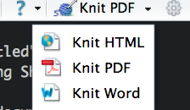
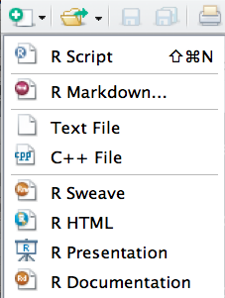
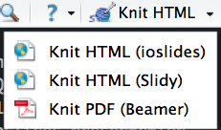
Documents
Slides

